Slide 1


I/O Organization
-Mahima Manni

Slide 2


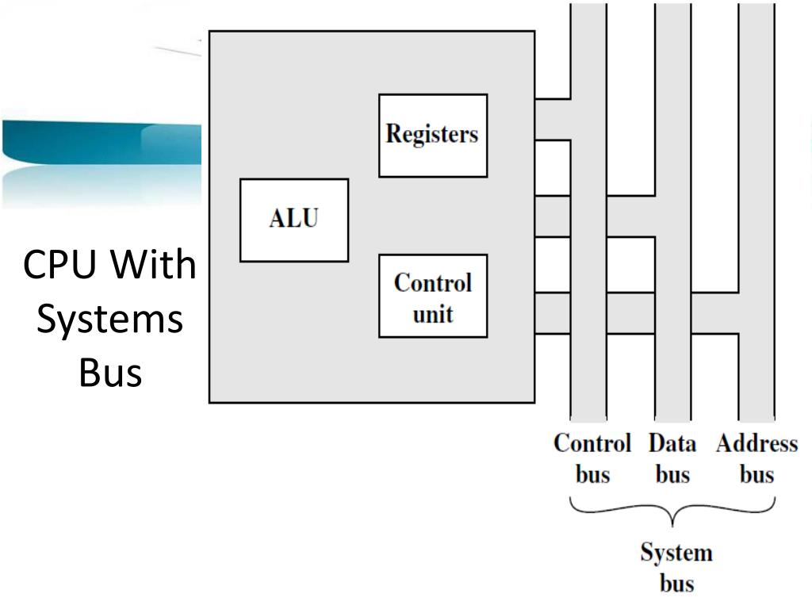
I/O Organization
The I/O subsystem of a computer provides an efficient mode of communication between the central system and the outside environment. It handles all the input-output operations of the computer system.

Slide 3
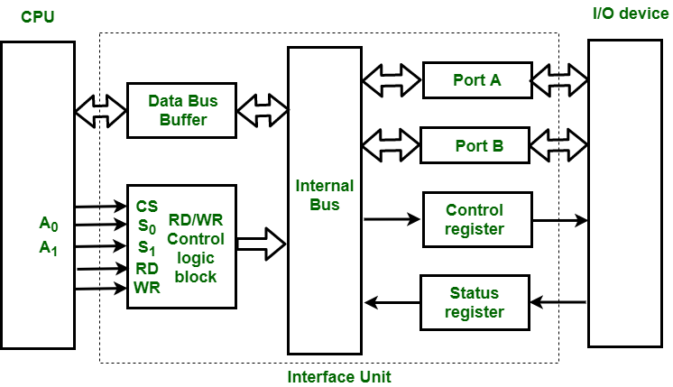
I/O Interface
Input-Output interface provides a method for transferring information between internal storage and external I/O devices. Peripherals connected to a computer need special communication links for interacting them with the central processing unit. The purpose of the communication link is to resolve the differences that exist between the central computer and each peripheral.

Slide 4
Peripherals
Peripherals are electromechanical and electromagnetic devices and their manner of operation is different from the operation of the CPU and memory, which are electronic devices. Therefore, a conversion of signal values may be required.
The data transfer rate of peripherals is usually slower than the transfer rate of the CPU, and consequently, a synchronization mechanism may be needed.
Data codes and formats in peripherals differ from the word format in the CPU and memory.
The operating modes of peripherals are different from each other and each must be controlled so as not to disturb the operation of other peripherals.

Slide 5
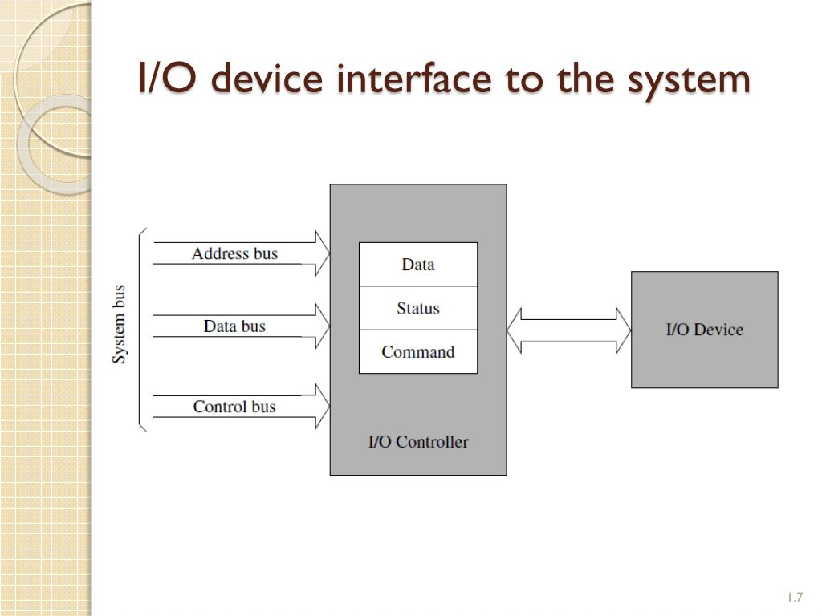
I/O Interfaces
To resolve the previous differences, computer systems include special hardware components between the CPU and peripherals to supervise and synchronize all input and output transfers. These components are called interface units because they interface between the processor bus and the peripheral device. In addition, each device may have its own controller that supervises the operations of the particular mechanism in the peripheral.

Slide 6
Functions of Input-Output Interface:
It is used to synchronize the operating speed of CPU with respect to input-output devices.
It selects the input-output device which is appropriate for the interpretation of the input-output device.
It is capable of providing signals like control and timing signals.
In this data buffering can be possible through data bus.
There are various error detectors.
It converts serial data into parallel data and vice-versa.
It also convert digital data into analog signal and vice-versa.

Slide 7
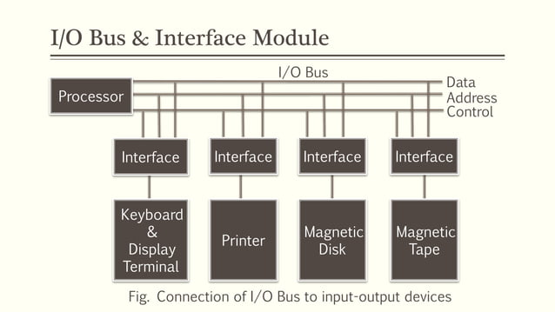
I/O Bus and Interface Modules

Slide 8
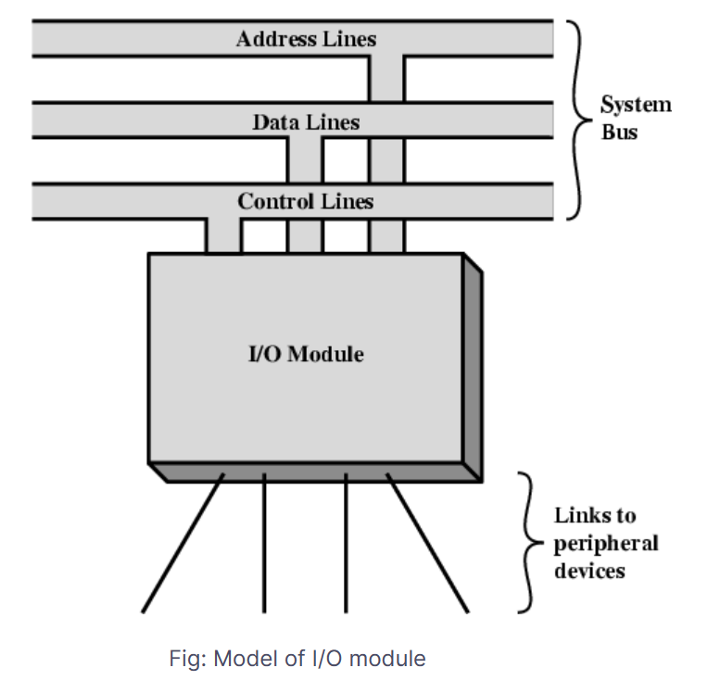
I/O modules interface to the system bus or central switch (CPU and Memory), interfaces and controls to one or more peripheral I/O operations are accomplished through a wide assortment of external devices that provide a means of exchanging data between external environment and computer by a link to an I/O module. The link is used to exchange control status and data between I/O module and the external devices.

Slide 9
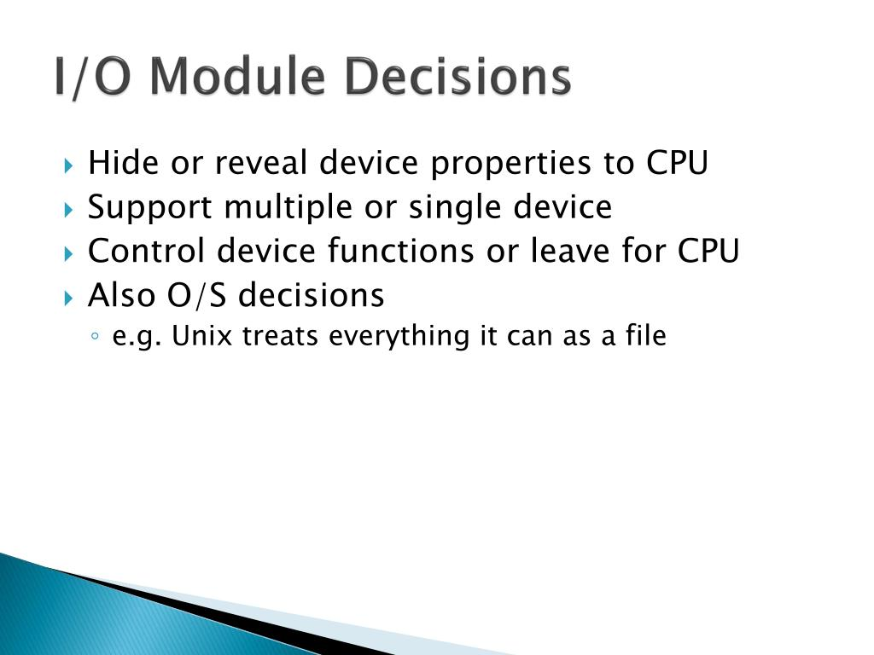
I/O Module Decisions

Slide 10
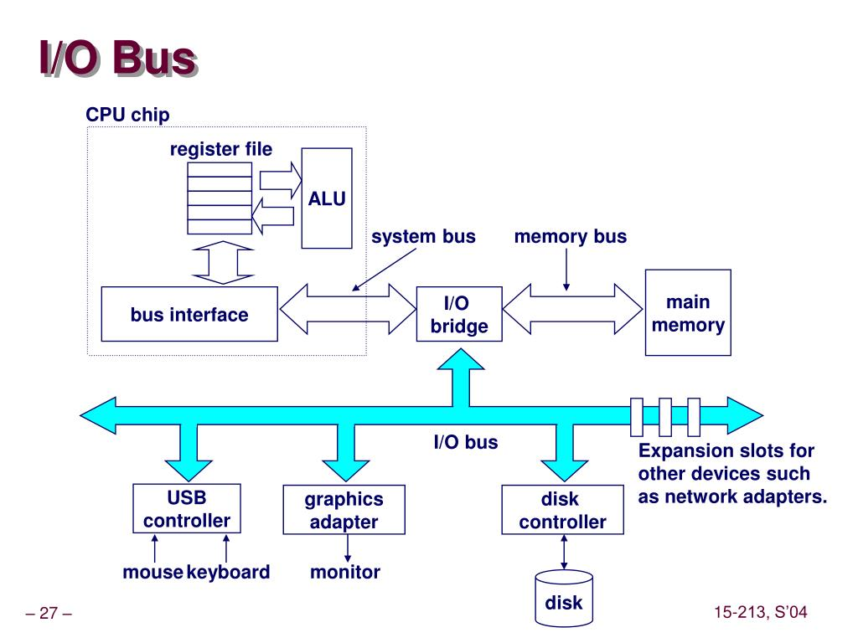
I/O versus Memory Bus
The memory bus and the I/O bus are two different types of buses that are used in computer systems. The memory bus is used to transfer data between the CPU and the memory, while the I/O bus is used to transfer data between the CPU and the I/O devices.
The memory bus and the I/O bus are two different types of buses that are used in computer systems. The memory bus is used to transfer data between the CPU and the memory, while the I/O bus is used to transfer data between the CPU and the I/O devices .
There are two ways in which data can be transferred between the CPU and I/O devices: memory-mapped I/O and isolated I/O .

Slide 11
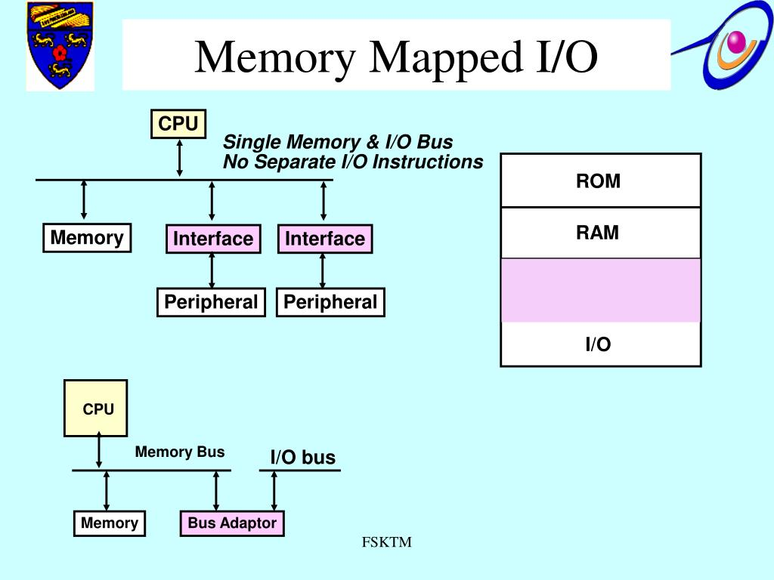
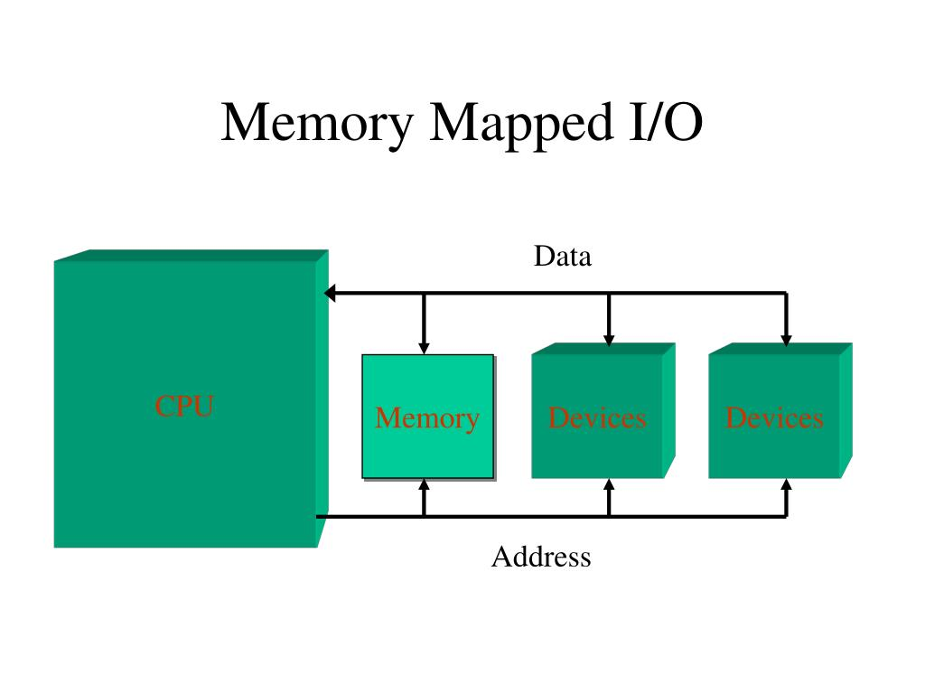
Memory-mapped I/O
In memory-mapped I/O, both memory and I/O devices use the same address space. This means that some of the memory addresses are assigned to I/O devices, which reduces the addressing capability of memory
. Memory-mapped I/O allows the CPU to access I/O devices at the same speed as it accesses memory, which means that I/O operations can be performed much faster compared to isolated I/O . Memory-mapped I/O also simplifies programming as the same instructions can be used to access memory and I/O devices, reducing programming complexity.

Slide 12
Isolated I/O
In isolated I/O, we have a common bus (data and address) for both memory and I/O devices but separate read and write control lines for I/O. When the CPU decodes an instruction, if data is for I/O, it places the address on the address line and sets the I/O read or write control line on due to which data transfer occurs between CPU and I/O. The address space of memory and I/O is isolated, and the name is so. The address for I/O here is called ports. Here we have different read-write instructions for both I/O and memory.

Slide 13


